Slide 1


Network Forensic Analysis
The Art of Discovery
Purple Hat Presentation by: By Mcards (Melvyn, Felix, Chris, Atul, Ramesh, Donna, and Samantha)
Notes:
Felix
MF (My Fedora)

Slide 2

Table of Contents
This document contains the following resources:
Network Topology & Critical Vulnerabilities
Traffic Profile
Normal Activity
Malicious Activity

Slide 3

Network Topology
& Critical Vulnerabilities
‹#›

Slide 4
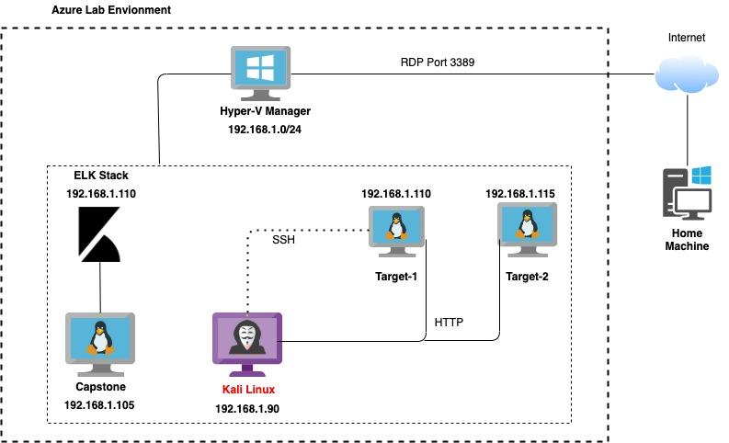

Network Topology
[Insert Here]
Use draw.io to create a diagram of the network.
Add your diagram to this slide and fill out the data in the sidebar.
Network
Address Range: 192.168.1.0/24
Gateway: 192.168.1.1
Machines
IPv4: 192.168.1.90
OS: Debian Kali 5.4.0
Hostname: Kali
IPv4: 192.168.1.110
OS: Debian GNU/Linux 8
Hostname: Target 1
IPv4: 192.168.1.115
OS: Debian GNU/Linux 8
Hostname: Target 2
IPv4: 192.168.1.105
OS: Ubuntu 18.04
Hostname: Capstone
IPv4: 192.168.1.100
OS: Ubuntu 18.04
Hostname: ELK
Notes:
Atul

Slide 5
Critical Vulnerabilities: Target 1
Our assessment uncovered the following critical vulnerabilities in Target 1.
Vulnerability | Description | Impact
Credential in plain text within Database | Unencrypted passwords within accessible database | Unauthorized user can easily obtain username & password with database creds
netbios-ssn | 139/tcp | Samba smbd 3 (network file sharing protocol).
Accessible password hashes & weak password requirements | Password hash was accessible and unprotected. Additionally, a user password was the same as the user name | Access password hash allows bad actor to “crack” password using available tools. Weak password allows bad actors to easily guess password
22/tcp | Default port 22 is open for SSH | Any user is able to ssh into the server with known credentials.
Old version of Wordpress | Wordpress version 3.7.8 | Vulnerabilities have been patched in later versions

Slide 6

Traffic
Profile
‹#›

Slide 7
Traffic Profile
Our analysis identified the following characteristics of the traffic on the network:
Feature | Value | Description
Top Talkers (IP Addresses) | 185.243.115.84 172.16.4.205 | Machines that sent the most traffic.
Most Common Protocols |  | Three most common protocols on the network.
# of Unique IP Addresses | 808 | Count of observed IP addresses.
Subnets | 10.0.0.0/8, 192.168.1.0/24, 172.16.0.0/16 | Observed subnet ranges.
# of Malware Species | 3 | Number of malware binaries identified in traffic.
Kerberos (KRB5) NetBios-NS
Domain
HTTP/S
TCP
LDAP
Notes:
You may have more than 2 subnets.
Chris/Felix -> Subnets

Slide 8

Behavioral Analysis
Purpose of Traffic on the Network
Users were observed engaging in the following kinds of activity:
“Normal” Activity
Browsing the internet
Short lived internet traffic
Network file sharing via intranet
Suspicious Activity
Browsing the internet for malware or suspicious sites such as how to hack and torrent downloads
Excessive HTTP error
HTTP request size
Notes:
Wordpress traffic
Excessive HTTP errors (400 error), HTTP request size (packet)

Slide 9


Normal Activity
‹#›

Slide 10
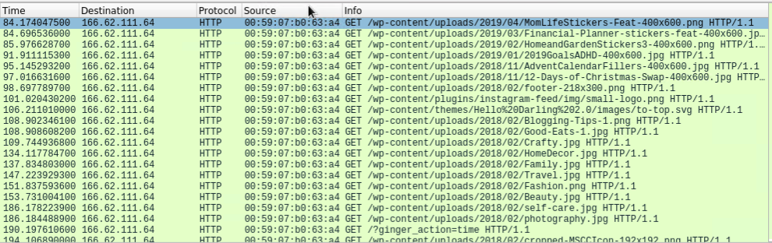


Normal web traffic
Summarize the following:
What kind of traffic?
Internet traffic to websites
Protocol: HTTP
User was surfing the web
Site were they browsing?
Instagram, Blogging Tips
Interesting files:
Blogging-Tips-1.png
small-logo.png
Notes:
First Behavior for Normal traffic
Samantha

Slide 11
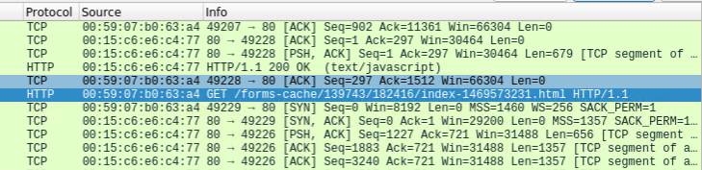
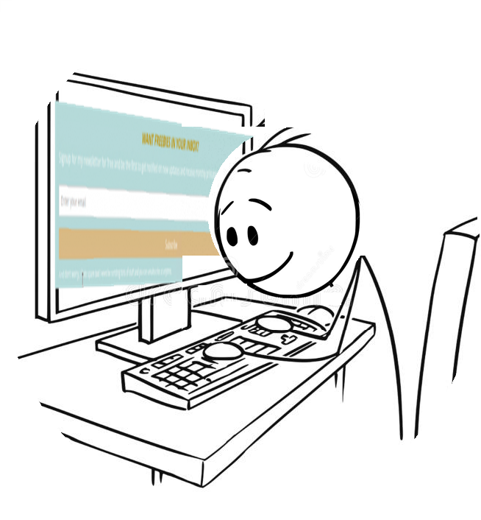
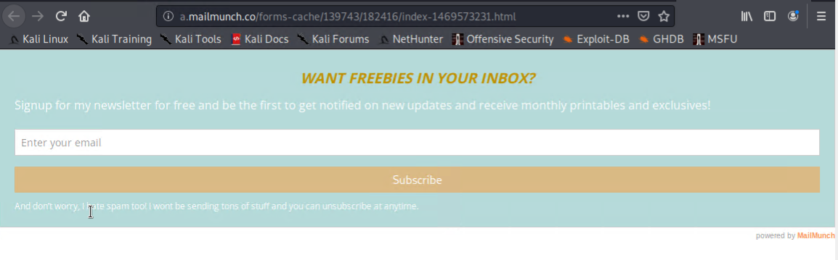
Normal web traffic
Summarize the following:
What kind of traffic?
Internet traffic to websites
Protocol: HTTP
User was surfing the web
Which site were they browsing? Mailmuch.co
Interesting files/sites:
a.mailmuch.co
Notes:
First Behavior for Normal traffic
Samantha

Slide 12

Malicious Activity
‹#›

Slide 13
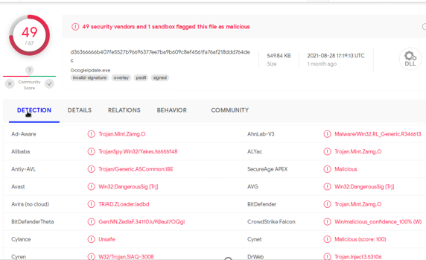


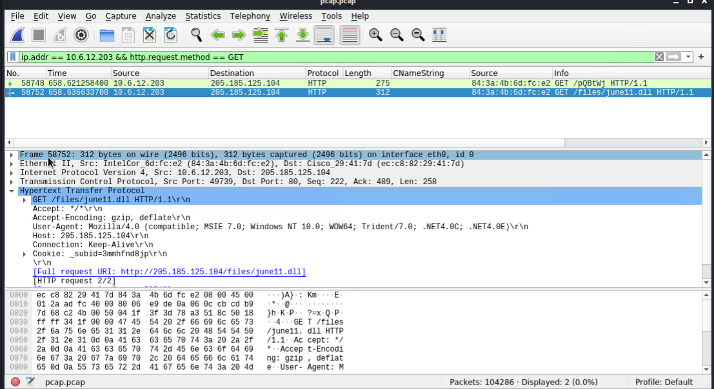
Malware download
Protocol
HTTP
Network traffic analysis
User downloaded a malware to the 10.6.12.203 machine
Malware type
Trojan
Interesting file
June11.dll

Slide 14

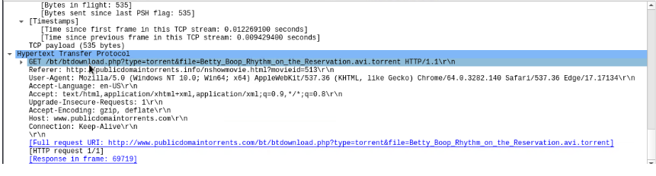
Illegal download
Protocol
HTTP
Traffic
User was browsing www.publicdomaintorrents.com
Malware/interesting file type
Torrent
Interesting files
Betty_Boop_Rhythm_on_the_Reservation.avi.torrent
Notes:
Torrent a download file to a download location.
computer file that contains metadata about files and folders to be distributed, and usually also a list of the network locations of trackers, which are computers that help participants in the system find each other and form efficient distribution groups called swarms.
A torrent file acts like a table of contents (index) that allows computers to find information through the use of a Bittorrent client

Slide 15
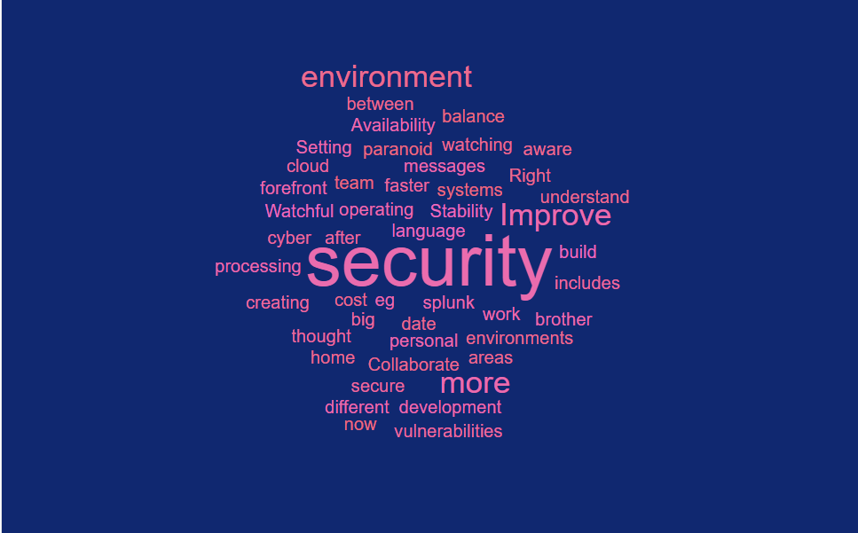
Notes:
Be paranoid that big brother is watching
Setting up cloud environments
Availability and Stability of the environment includes cyber security
Watchful of creating more secure environment at work
Security should be forefront not the after thought in development and build
Right balance between cost and security
Be aware of the vulnerabilities if operating systems are not up to date
Collaborate more with security team in different areas (We understand their language now)
eg: Improve splunk messages for faster processing
Improve personal and home security

Slide 16
The End
Copyright © 2021 All Rights Reserved
‹#›

